Slide 1

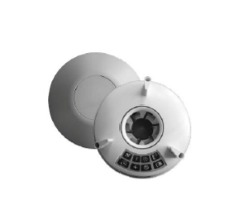

Ventilation Installation
What to Expect?
What is Ventilation?
Condensation in houses is a problem. This leads to moisture in the air resulting in water running down windows and the formation of black mould on walls and ceilings. Having the correct insulation and heating systems in your property helps reduce condensation but adding a continuously running ventilation fan working alongside these measures, will strengthen the reduction of humidity.
Placing an extractor/ventilation fan in bathrooms, kitchens and utility rooms works with the natural airflow in the house meaning you will have a constant flow of fresh air which prevents germs and gives you a healthy home without heat loss.
What materials are used?
The ventilator fans have an incorporated LED display. There are different mode settings, and the installer will program this in for you in line with the ventilation location.
What are the benefits?
Ventilator fans will prevent the build-up of moisture, remove steam and odour during cooking and prevent black mould forming on walls and ceilings.
They are very energy efficient and have low running costs. Some models we use 3p a week worth of energy.
Why am I having this done?
We are working with your housing association to support their decarbonisation goals. This means updating homes with more energy-efficient products. This process is called Retrofit.
Is it quite disruptive?
Getting ventilators installed will have minimal disruption to you and your surroundings.

Slide 2

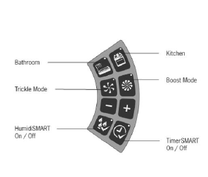
What is the installation process?
Step 1 – Assessment
Step 2 – Installation booked
Your property will have undergone a retrofit assessment. This allows the team to come and see your property so they can design your specific ventilation system.
An installation date will be agreed upon at your convenience.
Step 3 – On the day
The installer will use the ventilator plate to mark out the holes needed. Then they will drill the holes ready for the fixings. The ventilator will then be fully fixed to the wall, and you will be shown how to use it.
How do I care for my Ventilators?
Ventilator fans are low maintenance. For optimal performance, it’s important to keep your fan running continuously. Regular cleaning is required as over time, dust and debris can build up. You can also use a vacuum cleaner with a brush attachment.
Make sure the vent and ducts are not obstructed.
Handover Pack
You will be given a full product specification guide upon completion, showing how to use and maintain your new energy-efficient products, and contact details if you have any issues.

