Slide 1

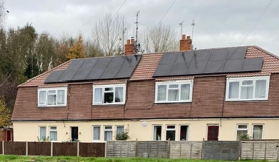

Solar PV
What to Expect?
What is Solar PV?
Solar panels, or photovoltaics (PV) absorb the solar energy from the sun via individual PV cells. These cells are made up of layers of semi-conducting material called silicon. Energised by the sun, these cells produce an electrical charge, so the stronger the sunshine, the more electricity is generated. However, these cells do not always need direct sunlight to work, they can even work on cloudy days.
This electrical charge creates a direct current (DC) of electricity and passes through the solar inverter to turn it into alternating current (AC) electricity so you can run your household appliances.
What materials are used?
Before the installation day, scaffolding will be erected on your property.
The solar PV systems consist of:
Solar Panels
Inverter – this converts the DC electricity generated by the panels into AC electricity for your home
Mounting system – this secures your panels to the roof
Monitoring system – This helps you track the performance of your solar panels.
What are the benefits?
Solar electricity is a clean, renewable energy source. As sunlight is free, the electricity generated from your solar panels will significantly reduce your energy bills.
Why am I having this done?
We are working with your housing association to support their decarbonisation goals. This means updating homes with more energy-efficient products. This process is called Retrofit.
Is it quite disruptive?
The solar panel installation process may at times be noisy due to the drilling, but it shouldn’t make any mess and will have minimal disruption.

Slide 2

What is the installation process?
Step 1 – Assessment
Step 2 – Installation booked
Your property will have undergone a retrofit assessment. This allows the team to come and see your property so they can design your specific Solar PV system.
An installation date will be agreed upon at your convenience.
Step 3 – On the day: The Mounting System
Step 4 – On the day: Attach the panels
The installers will be working on your roof either at the front or the back or maybe both. They will start by fixing the mounting system to the roof.
The panels will then be securely fixed to mounting brackets using clamps.
Step 5 – On the day: Connecting the panels
Step 5 – On the day: Installing the inverter
The panels will be connected in a series depending on the system design.
The inverter will be mounted near the main electrical panel or fuse box and connected to the solar panels.
Step 7 – On the day: Connecting to the electrical system
Step 8 – On the day: Installing the monitoring system
The electrician will then connect the inverter to your property's electrical system.
The final stage will be the set-up of the monitoring system to track the performance of your solar panels. They will also take you through app or online portal depending on the solar panel system.
How do I care for my Solar PV ?
Handover Pack
Solar panels require very low maintenance.
Keeping the inverter area clear is important to allow good airflow and easy access if maintenance is needed.
Avoid touching the panels or inverter. The solar PV system is designed to operate automatically. There's no need to adjust the panels or touch the inverter.
The solar panels are designed to withstand various weather conditions, and it is good to get into the habit of checking your panels after storms or high winds to make sure the roof is free from debris.
You will be given a full product specification guide upon completion, showing how to use and maintain your new energy-efficient products, and contact details if you have any issues.

