Slide 1

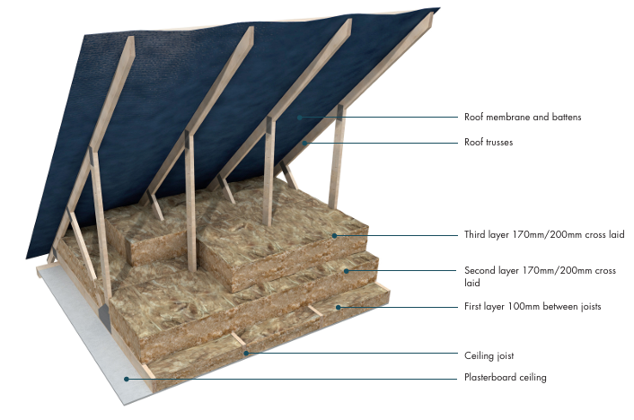

Loft Insulation
What to Expect?
What is Loft Insulation – LI?
Loft insulation is the barrier of material, usually mineral fibre wool, in your roof spaces that traps heat. It keeps your house warm in the winter and cool in the summer.
What materials are used?
The typical tools and materials you will see during a loft installation are:
  Rolls of mineral fibre wool insulation wrapped in recyclable packaging
  Sealant
  Tape
  Crawl boards
  Staple guns
  Knives
  PPE
Why am I having this done?
We are working with your housing association to support their decarbonisation goals. This means updating homes with more energy-efficient products. This process is called Retrofit.
What are the benefits of LI?
Loft insulation will lower your heating bills, improve your home's energy efficiency rating as well as increase the value of the property.
Is it quite disruptive?
If you use your loft for storage, then the only disruption would be the clearing out of the stored items. Otherwise, this is little or no disruption during this measure.

Slide 2

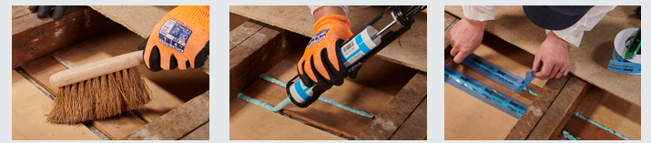
What is the installation process?
Step 1 – Assessment
Step 2 – Installation booked
Your property will have undergone a retrofit assessment. This allows the team to come and see your property so they can design your specific loft insulation. These will be shown to you before work starts.
An installation date will be agreed upon at your convenience.
Step 3 – On the day
The loft will need to be cleared of all items and the installer will prep the area by looking out for electrical or TV cabling, water piping, ventilation provisions and other features that may need to be considered before installation starts.
Airtightness measures will then be made, sealing off any gaps where air could leak into the roof space using a high-quality sealant and/or tape.
Our installers will be fully kitted out in full PPE at this stage. Starting at the eaves, the rolls of required insulation will then be opened and laid out. One – two layers may be used during the install. We will then insulate the loft hatch.
Once completed, the loft should be fully covered in a consistent depth of insulation with all gaps filled.
How do I care for my LI?
Handover Pack
Once the loft installation is installed it will require minimal maintenance.
Insulation is most effective when it remains dry. If you notice any signs of samples or mould in your loft, contact us immediately. Moisture can compromise the insulation and lead to long-term damage.
Storage: heavy boxes or items that are not stored properly can displace the insulation and reduce its effectiveness.
Good ventilation is key to maintaining the effectiveness of your loft insulation. Ensure that your loft vents are not blocked by insulation or other items allowing proper airflow.
You will be given a full product specification guide upon completion, showing how to use and maintain your new energy-efficient products, and contact details if you have any issues.

